Slide 1


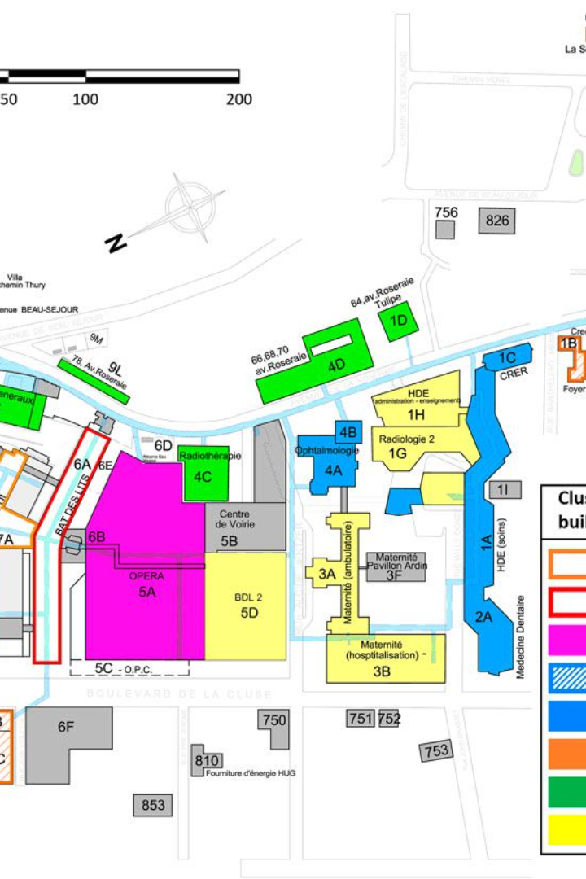


MediTour
By - Code Warriors
An introduction to Health Tech Facility Mapping
Health tech facility mapping allows hospitals to provide a visual representation of their facilities to the public, making it easier for patients and visitors to navigate the premises.
Notes:
1

Slide 2

Team Members
Naman Bansal(Team Leader)
Ishita Tyagi
Harsh Verma
Hamza Hasan
Notes:
2

Slide 3
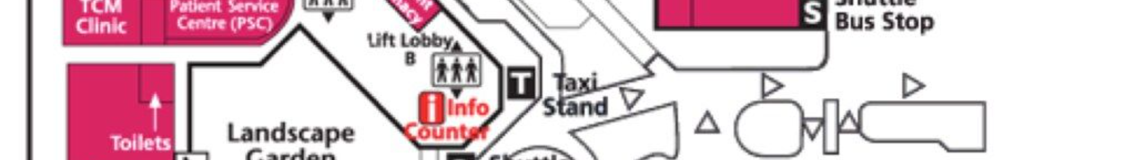
Purpose of Facility Mapping in Hospitals
1
Efficiency
Facility mapping helps optimize the layout and use of hospital spaces for better workflow and resource allocation.
2
Emergency Preparedness
It assists in creating evacuation plans and identifying emergency response locations for quick access during critical situations.
3
Visitor Experience
Enhancing the experience for patients, visitors, and staff by providing clear, easy-to-follow directions to different departments and facilities within the hospital.
Notes:
3

Slide 4
Benefits of Facility Mapping for the Public
Reduced Stress
Time Saving
Improved Accessibility
Minimizes confusion and stress for patients and visitors navigating the complex hospital environment.
Enables people to reach their destinations within the hospital quickly, saving time and reducing frustration.
Enhances accessibility, making it easier for individuals with disabilities or mobility issues to find their way around.
Notes:
4

Slide 5
Features and Functionalities of Health Tech Facility Mapping
1
Interactive Maps
2
Real-Time Updates
3
Immersive Realities
Users can interact with maps on digital devices to locate specific facilities or points of interest within the hospital.
Provides information on current waiting times, bed availability, and any ongoing maintenance or construction work.
We are going to give the user the visual implementation of our registered hospitals through AR VR.
Notes:
5

Slide 6
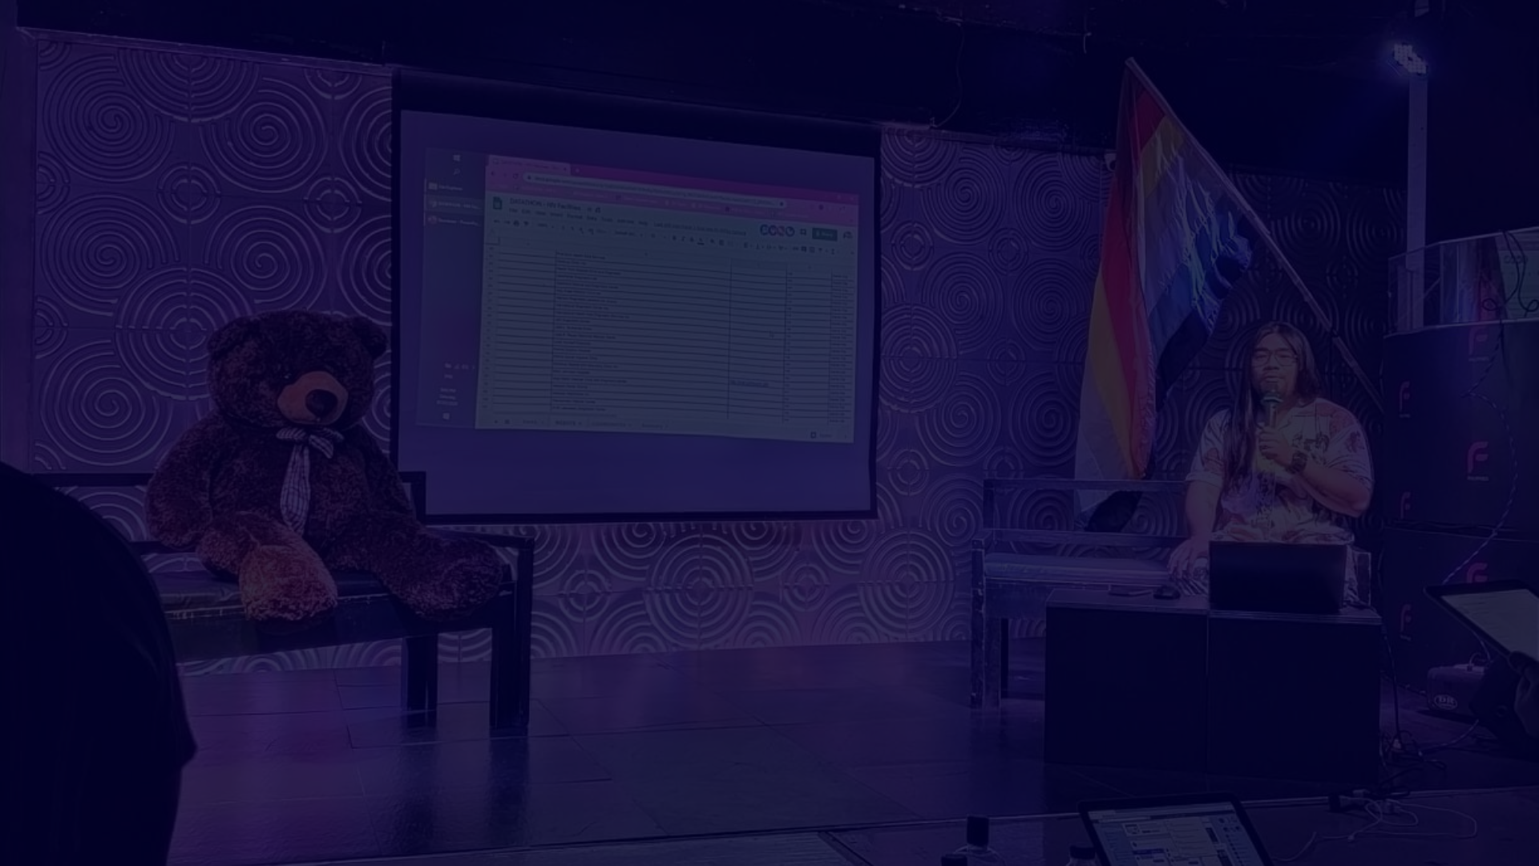



How to Access and Use Health Tech Facility Mapping
Download the App OR Login to web page
Search for Locations
Navigation Assistance
Enter the desired department or facility name in the search bar or use the built-in search function to find specific locations.
Receive step-by-step directions and real-time location tracking to guide users to their intended destinations.
Users can download the hospital's dedicated facility mapping app or directly assessing our web page .
Notes:
6

Slide 7
Examples of Successful Implementation of Facility Mapping in Hospitals
Patient Outcomes
Operational Efficiency
Positive Feedback
Improved patient satisfaction and reduced anxiety resulting from easier navigation and faster access to care.
Positive feedback from patients and visitors on the ease of navigating the hospital's facilities.
Enhanced hospital operations, smoother patient flow, and better resource management.
Notes:
7

Slide 8
Challenges and Considerations in Implementing Health Tech Facility Mapping
1
2
3
Data Accuracy
Privacy Concerns
Technology Adoption
Ensuring that the mapping data is accurate and updated to reflect any changes in the hospital's infrastructure.
Addressing privacy and security issues related to location tracking and personal data within the mapping system.
Overcoming resistance to using new technology and providing adequate training for users.
Notes:
8

Slide 9


Conclusion and Future Prospects of Health Tech Facility Mapping
Integration of AI Chatbot
Integration with Smart Devices
for better experience of user we can integrate a chatbot which resolves the basic questioning of the users.
Integration with smart devices and wearables to offer personalized, location-based guidance for patients and visitors.
Notes:
9

Slide 10



Tech stack
Web Development
To design our website which included:
Introductory page
Login Page
List of Hospitals
Hospital Details
Android Development
To design our app which included:
App for virtual tour of hospital
Login page
Pharmacy
AR/VR
To design:
Virtual tour of rooms
3-D Model

Slide 11
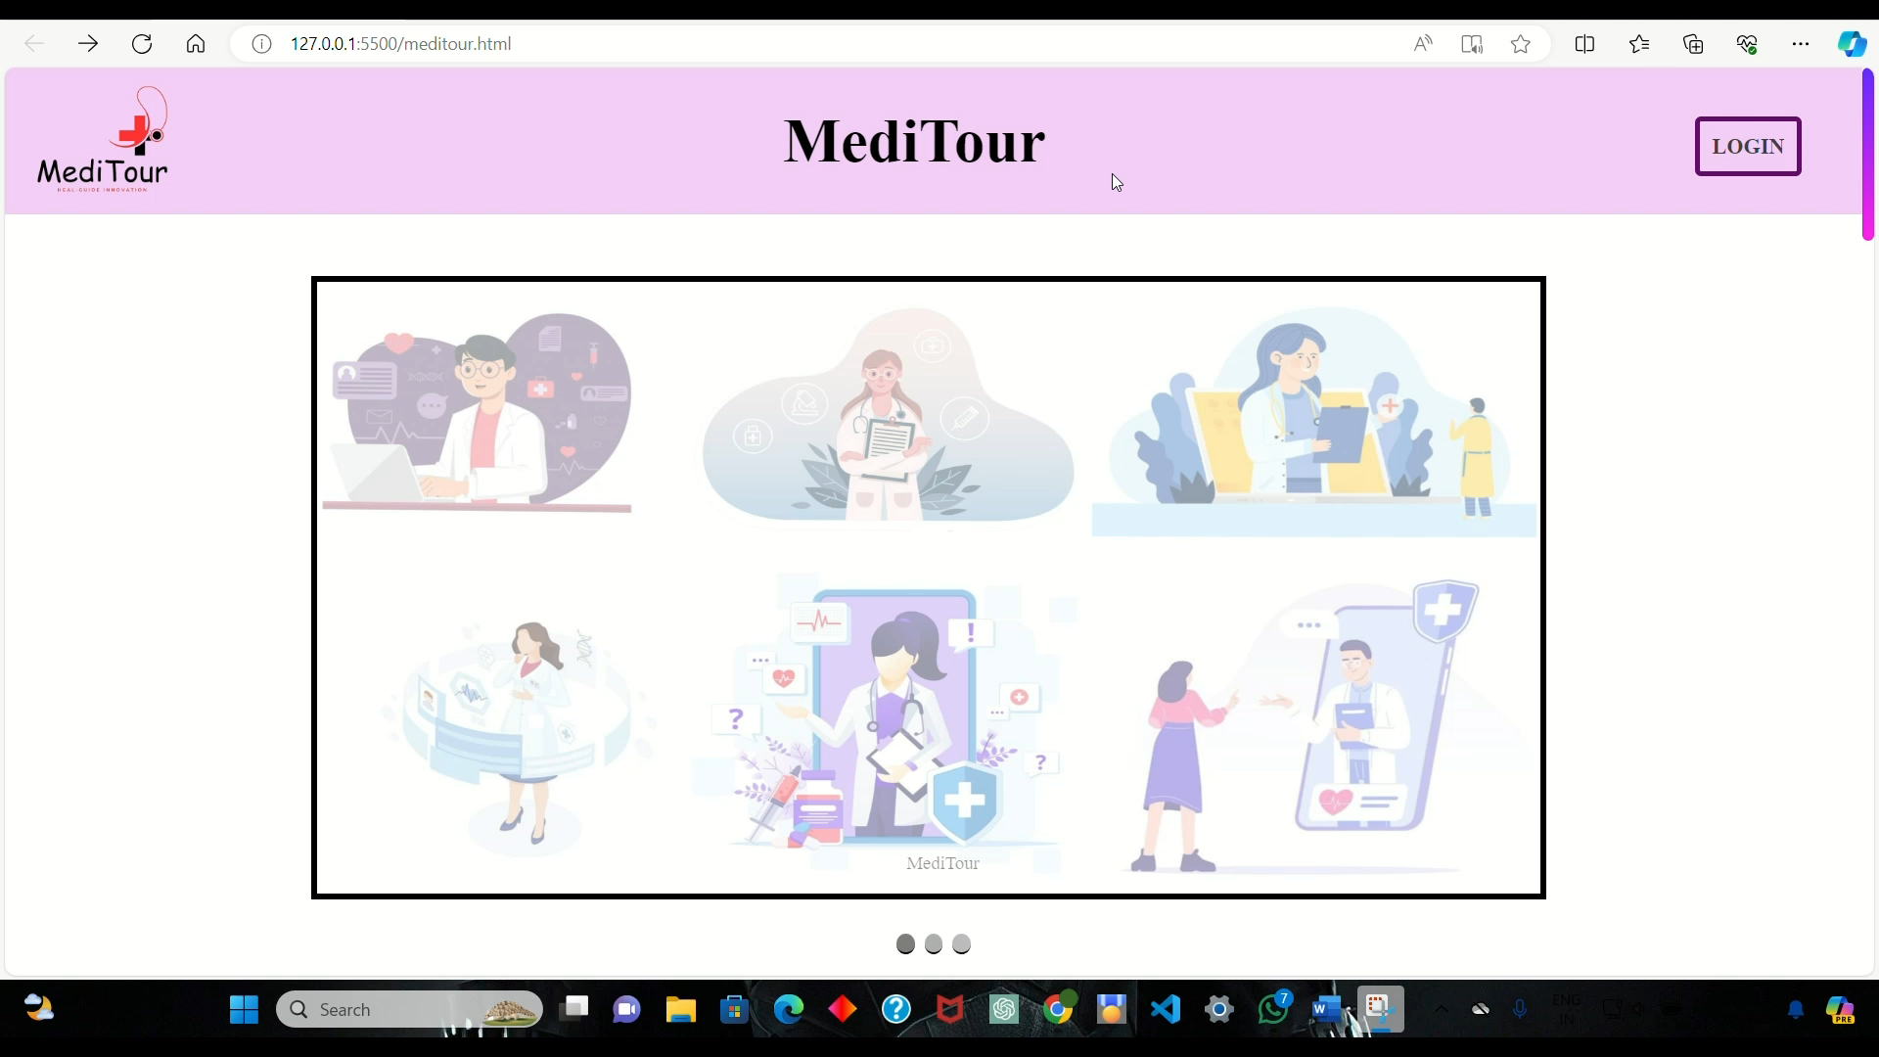

Slide 12

VIRTUAL TOUR OF HOSPITAL

Slide 13
THANK YOU!

